Slide 1
SE2001 Software Requirement Engineering (SRE) Fall 2021
Sandia Kumari
Lecture # 4
September 14, 2021

Slide 2
Objectives of this Week
To introduce the notion of processes and process models for requirements engineering
To explain the critical role of people in requirements engineering processes
To explain why process improvements is important and to suggest a process improvement model for requirements engineering

Slide 3
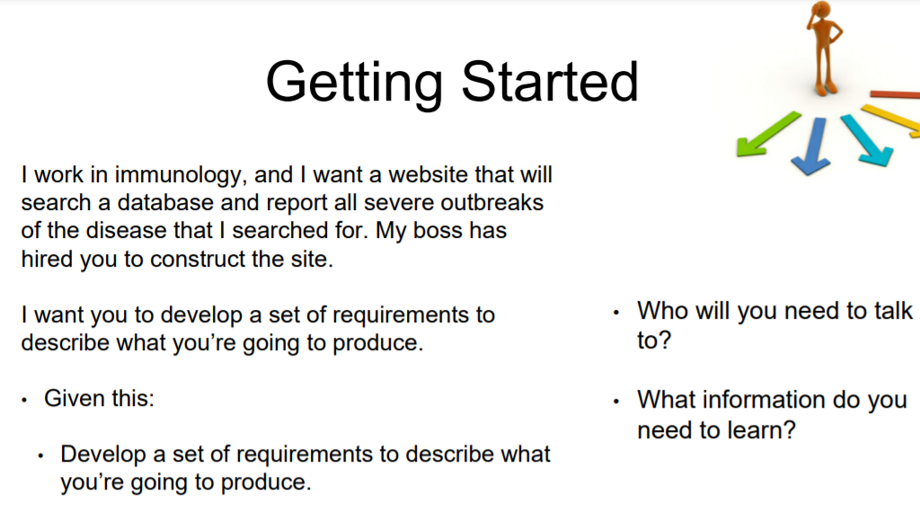

Slide 4
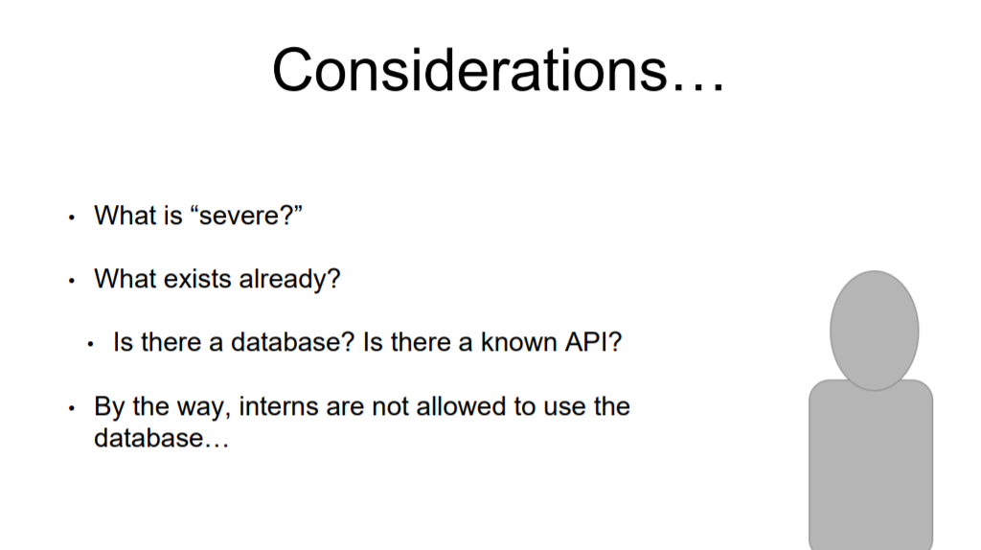

Slide 5

Processes
A process is an organized set of activities which transforms inputs to outputs
Process descriptions encapsulate knowledge and allow it to be reused
Examples of process descriptions
Instruction manual for a dishwasher
Cookery book
Procedures manual for a bank
Quality manual for software development

Slide 6
Design processes
Processes which involve creativity, interactions between a wide range of different people, engineering judgment and background knowledge and experience
Examples of design processes
Writing a book
Organizing a conference
Designing a processor chip
Requirements engineering

Slide 7
RE process - inputs and outputs

Slide 8
Input/output description

Slide 9
RE process variability
RE processes vary radically from one organization to another
Factors contributing to this variability include
Technical maturity
Disciplinary involvement
Organizational culture
Application domain
There is therefore no ‘ideal’ requirements engineering process

Slide 10
Process models
A process model is a simplified description of a process presented from a particular perspective
Types of process model include:
Coarse-grain activity models
Fine-grain activity models
Role-action models
Entity-relation models

Slide 11
Coarse-grain activity model of RE

Slide 12
RE process activities
Requirements elicitation
Requirements discovered through consultation with stakeholders
Requirements analysis and negotiation
Requirements are analyzed and conflicts resolved through negotiation
Requirements documentation
A requirements document is produced
Requirements validation
The requirements document is checked for consistency and completeness

Slide 13
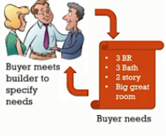
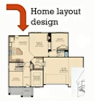
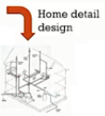



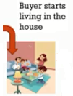
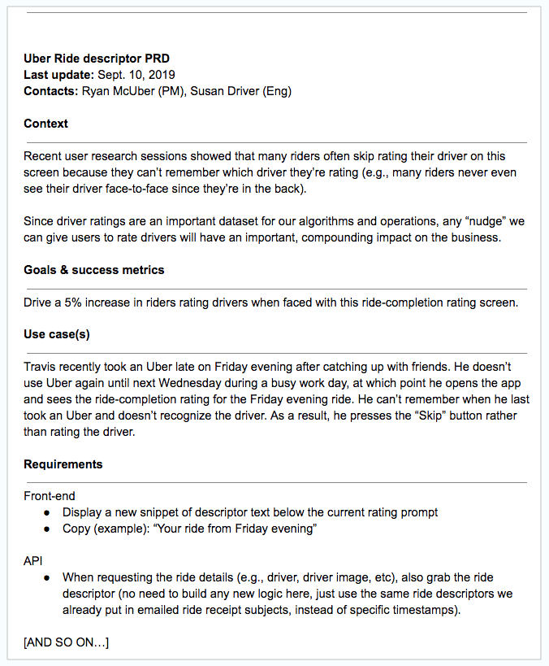
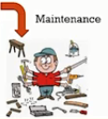
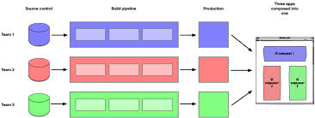
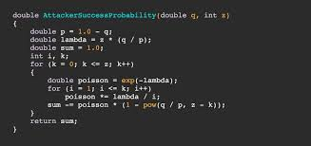
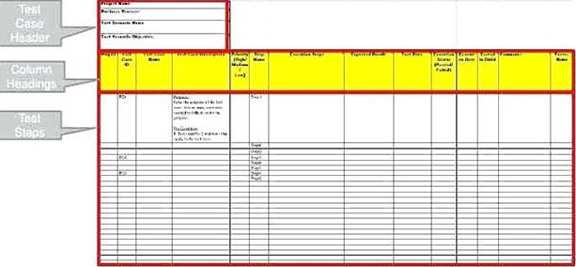
Requirements
Design
Implementation
Requirement Analysis Prototyping
Verification
Architecture, High Level Design, Low Level Design
Coding, Unit Testing
Integration Testing, UAT
Operation and Maintenance

Slide 14
Waterfall model of the software process

Slide 15
Context of the RE process

Slide 16
Spiral model of the RE process

Slide 17
Domain Requirements
Requirements imposed by a system’s operational domain
‒ For example. a train control system has to take into account the braking characteristics in different weather conditions
How they are defined? ‒ Can be either new functional requirements or constraints on existing requirements
Why use domain requirements?
‒ To make the system workable ‒ If not satisfied, the system may not work

Slide 18
Actors in the RE process
Actors in a process are the people involved in the execution of that process
Actors are normally identified by their roles rather than individually
Requirements engineering involves actors who are primarily interested in the problem to be solved (end-users, etc) as well actors interested in the solution (system designers, etc.)
Role-action diagrams document which actors are involved in different activities

Slide 19
RAD for software prototyping

Slide 20
Role descriptions

Slide 21
Human and social factors
Requirements engineering processes are dominated by human, social and organizational factors because they always involve a range of stakeholders from different backgrounds and with different individual and organizational goals.
System stakeholders may come from a range of technical and non-technical background and from different disciplines

Slide 22
Types of stakeholder
Software engineers responsible for system development
System end-users who will use the system after it has been delivered
Managers of system end-users who are responsible for their work
External regulators who check that the system meets its legal requirements
Domain experts who give essential background information about the system application domain

Slide 23
Factors influencing requirements
Personality and status of stakeholders
The personal goals of individuals within an organization
The degree of political influence of stakeholders within an organization

Slide 24
Process support
CASE (Computer-Aided Software Engineering) tools provide automated support for software engineering processes
These tools support various activities such as software design, configuration management and testing.
The most mature CASE tools support well-understood activities such as programming, testing and project management
Support for requirements engineering is still limited because of the informality and the variability of the process

Slide 25
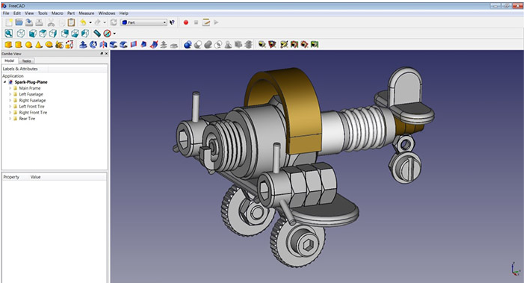
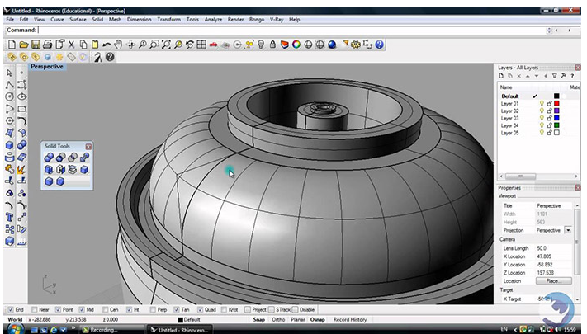
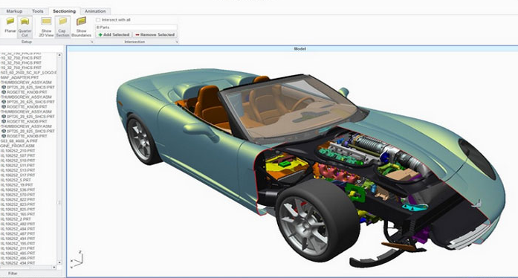
Computer Aided Design Software

Slide 26
Two types of CASE tools for RE
Modeling and validation tools support the development of system models which can be used to specify the system and the checking of these models for completeness and consistency.
Management tools help manage a database of requirements and support the management of changes to these requirements.

Slide 27
Tools for requirement management have been developed because of the problems of managing the large amount of data which is collected during the RE process & volatility of reqs
As well as data storage & retrieval facilities, these tools provide a change management system which can record change proposals, link these to the reqs affected & keep track of the status of changes.

Slide 28
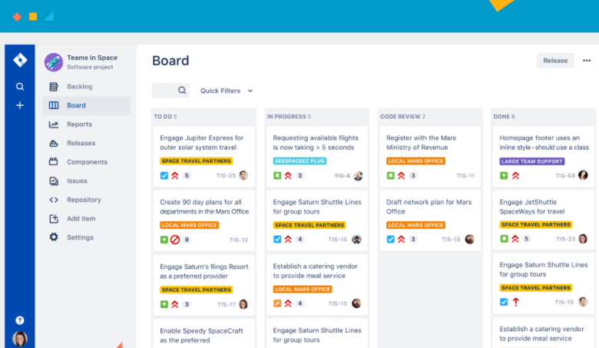
At the time of writing, there are several commercial CASE products available for requirement management such as DOORS, RML, RDD-100 and Requisite Pro.
We will use JIRA.

Slide 29
JIRA
Software used to help manage, develop and communication about work

Slide 30
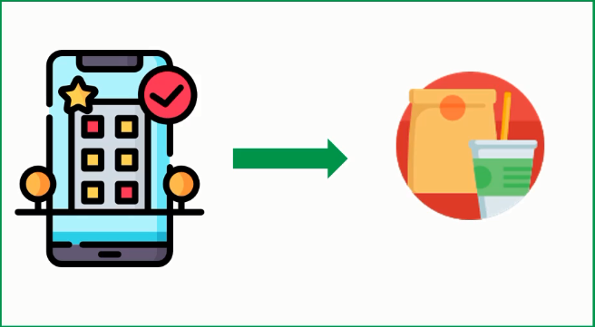
Case Study
Restaurant called “Karachi Foods” is looking for an Online Home Delivery Service for her Restaurant.
Ali is the Business Analyst part of the Consulting firm who is hired to set this up. He is going to use the User Story Mapping Technique to gather Business Requirements and for release prioritisation

Slide 31
EPIC
EPIC
EPIC
EPIC
Browse
Order
Pay
Track
Activity
Sequence
User
Story
User
Story
User
Story
User
Story
Grouped by
Categories
Registration
Cash
ETA
Release1
User
Story
User
Story
User
Story
User
Story
Search by keyword
Login
Debit/Credit
Card
Support
User
Story
Add & Remove
From Cart
Release2
User
Story
User
Story
Internet Banking
Order Progress
User
Story
User
Story
Release 3
Duplicate Previous Orders
User
Story
Payment Wallets
Live Tracking
Notes:
User Story Format:
As a Customer I want to view the food items arranged by categories so that I can easily select the food items
Acceptance Criteria GIVEN Customer is logged onto the online application WHEN Customer is on the home page THEN Customer should be able to see the food items grouped by categories
Supporting Models 1. Refer to the table below for the mapping between categories and food items
Table: Category Food item
Breakfast item1
Breakfast item2
Lunch item1
Lunch item 2
2. Refer to mockup attached for the navigation

Slide 32
What is a User story?
User stories are short description of a small piece of business functionality that usually take 1-3 days to complete.
They help us to break down specific product features into more bit- sized/manageable pieces.

Slide 33
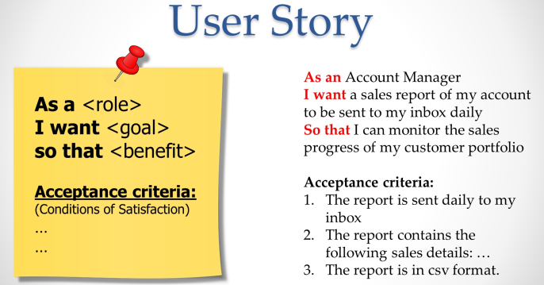
How to write a User story

Slide 34
Examples
As a database administrator I want to automatically merge datasets from different sources so that I can more easily create reports for my internal customers
As a school admin I want to print the records of students so that I can save them manually too
As a brand manager, I want to get alerts whenever a reseller advertises our products below agreed-upon prices so that I can quickly take action to protect our brand.
As the leader of a remote team, I want our team-messaging app to include file sharing and annotation so that my team can collaborate in real-time and keep an archive of their work in a single place.

Slide 35
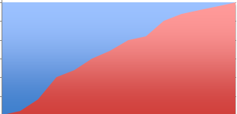



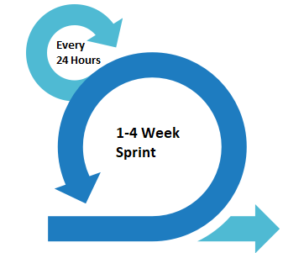

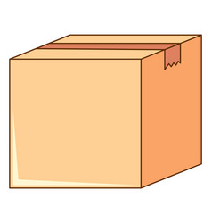
Scrum Framework
The Agile: Scrum Framework at a glance
Inputs from Executives,
Team, Stakeholders,
Customers, Users
Burn down/up chart
Scrum Master
Daily Scrum Meeting
Product Owner
The Team
Sprint Review
1
2
Ranked list of what is required features, stories
Team select starting at top as much as it can commit to deliver by end of Sprint
3
4
Task Breakout
5
6
7
Sprint
Backlog
Sprint end date and
tam deliverable
do not change
Finished Work
8
Sprint
Planning
Meeting
Product
Backlog
Sprint Retrospective

Slide 36
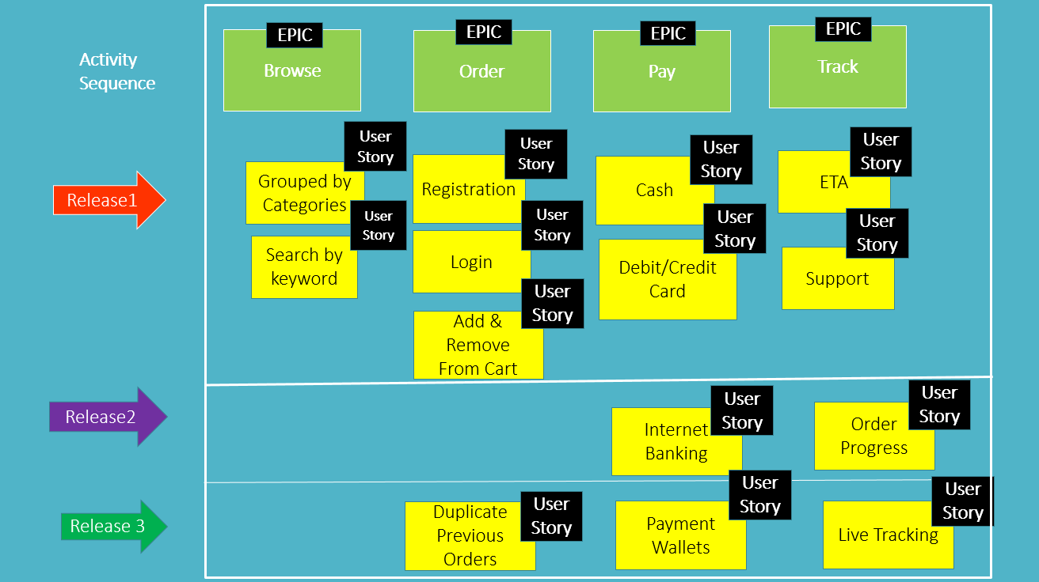
Map this project on JIRA

Slide 37
A requirements management system

Slide 38
Requirements management tools
Requirements browser
Requirements query system
Traceability support system
Report generator
Requirements converter and word processor linker
Change control system

Slide 39
RMS have been designed as general tools which maybe used in diff requirement engineering process. They do no, generally impose their own model of the requirements engineering process.
One area of requirement engineering where support is currently very limited is the area of elicitation. This area is difficult to support because wide range of different stakeholders who maybe involved in the process with diff notations & vocabularies.

Slide 40

The process to gather the software requirements from client, analyze and document them is known as ___________________.
A. Feasibility Study B. Requirement Gathering C. Requirement Engineering D. System Requirements Specification

Slide 41
The goal of requirement engineering is to develop and maintain sophisticated and descriptive _________________ document.
A. Feasibility Study B. Requirement Gathering C. Software Requirement Validation D. System Requirements Specification

Slide 42
It is the process in which developers discuss with the client and end users and know their expectations from the software.
A. Requirements gathering B. Organizing Requirements C. Negotiation & discussion D. Documentation

Slide 43
Which of the following is correct software metrics?
A. Complexity Metrics B. Quality Metrics C. Process Metrics D. All of the above

